Slide 1

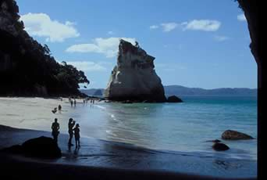
Present Perfect
How do we make the present perfect tense in English?
Can you think of the grammar rule?
Sofia has swum in the ocean many times.

Slide 2
The present perfect has 2 parts:
has
or
haVE
past
participle
+
But...what does “past participle” mean?

Slide 3
Past Participle
What is a past participle?
For regular past tense verbs, the –ed form: liked, walked, worked, talked
For irregular past verbs, memorize:
been, seen, had, eaten, shown, written

Slide 4
Yes/No Questions
?
You
have
you
finished
He
has
he
studied a lot
?

Slide 5
Wh- questions
What have you done?
Where have you been?
Where has the doctor studied?
What countries have they visited?

Slide 6
3 main uses

Slide 7
Use 1
Something that started in the past and is still true now
Examples:
-I have worked at ECC since 2000.
-Susan has lived in New York for a long time.
-I have known my best friend since I was 14.

Slide 8

I have studied in this university for a year.
Dr Jones has worked here since 1999.

Slide 9
Use 2
Indefinite past action Event that happened in the past, but we don’t know when, or it’s not important when.
Examples:
-I have flown on a plane before.
-Jim has traveled to Paris.
?

Slide 10

I have been to India many times.
She has visited Africa and Asia.
They have eaten insects.

Slide 11
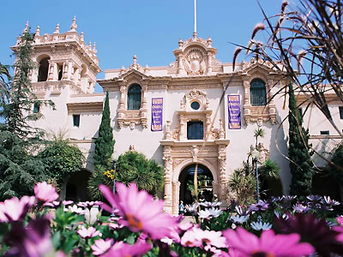
Use 3
Repeated past action (could happen again)
Examples:
-Juanita has gone to Balboa Park many times.
-I’ve flown on a plane a lot.

Slide 12
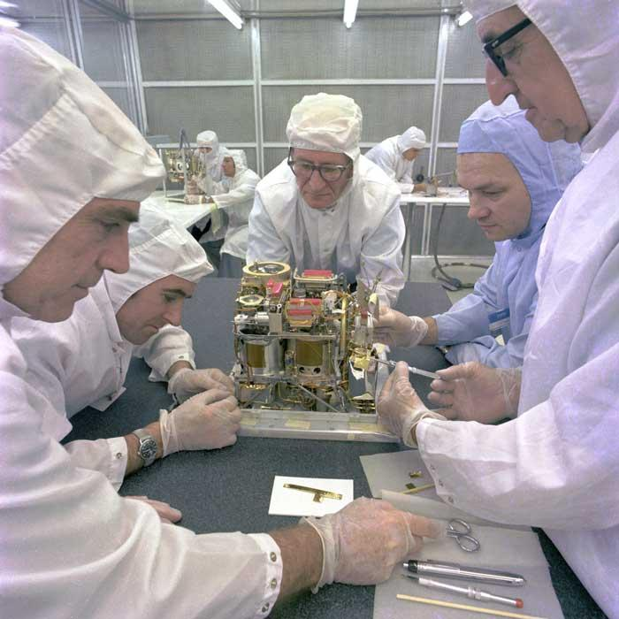
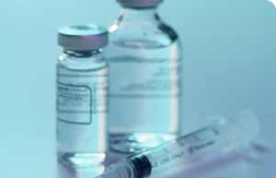
Key words for present perfect
Already = (adv.) before now
I have already finished my homework.
Not … yet = (adv.) not before now
Scientists have not discovered a cure yet.

Slide 13
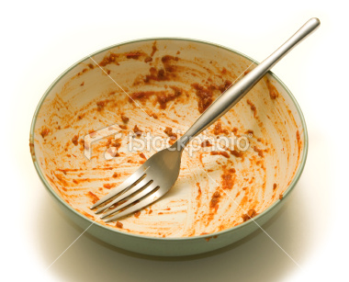
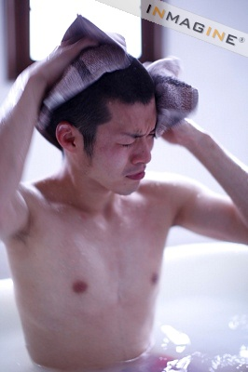
Reminder about Adverb Placement
Just = (adv.) completed recently
I have just finished my food.
He’s just taken a shower.

Slide 14
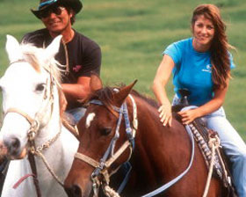
Key words for present perfect
Ever = (adv.) at any time, including the present
** Used only in questions
Have you ever ridden a horse?

Slide 15
Answer: Yes, I have or No, I haven’t
Have you ever visited Peru?
Have you ever eaten octopus?
Have you ever drunk rum?
Has your mother ever been to Argentina?
Have your teachers ever told a joke?
Have you seen a teacher in the street?
Have you ever saved a life?

Slide 16
4-3 LET’S PRACTICE
Kyung has already taken the test.
MEANING #1: Something happened before now at an unspecified time.
OR ?
MEANING #2: A situation began in the past and continues to the present.

Slide 17
4-3 LET’S PRACTICE
I’ve studied since 8 AM.
MEANING #1: Something happened before now at an unspecified time
OR ?
MEANING #2: A situation began in the past and continues to the present

Slide 18
4-3 LET’S PRACTICE
Rosa has been to Italy three times.
MEANING #1: Something happened before now at an unspecified time
OR ?
MEANING #2: A situation began in the past and continues to the present

Slide 19
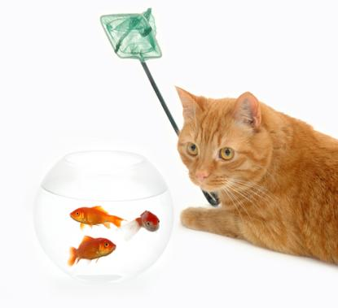
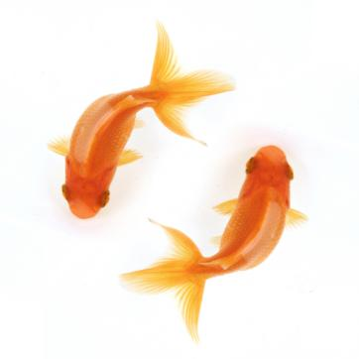
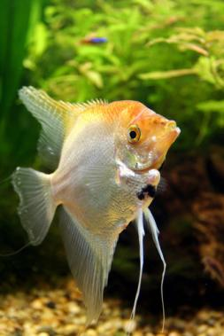
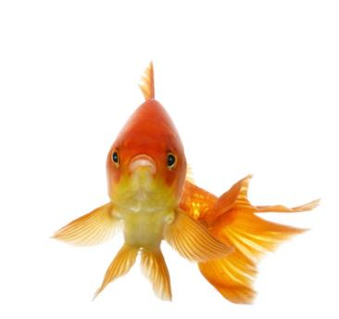
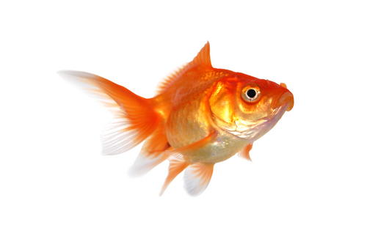
4-4 SIMPLE PAST vs. PRESENT PERFECT
I had an angel fish
when I was a child.
I have had many other
fish since then.

Slide 20
4-4 SIMPLE PAST vs. PRESENT PERFECT
SIMPLE PAST
(a) They completed the game at 4:00.
specific time
PRESENT PERFECT
(b) They have already completed the game.
unspecified time

Slide 21
4-4 SIMPLE PAST vs. PRESENT PERFECT
SIMPLE PAST
(c) I was in Nigeria when I was five years old.
specific time
PRESENT PERFECT
(d) I have been in Nigeria three times.
unspecified time

Slide 22
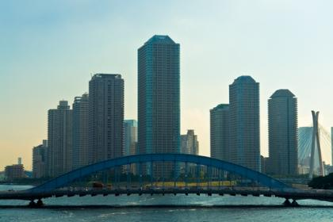
4-4 LET’S PRACTICE
?
SPECIFIED
OR
UNSPECIFIED TIME
We have been in Tokyo
many times.
PRESENT PERFECT
UNSPECIFIED

Slide 23

4-4 LET’S PRACTICE
?
SPECIFIED
OR
UNSPECIFIED TIME
Barry has never been to Tokyo.
PRESENT
PERFECT
UNSPECIFIED

Slide 24
4-4 LET’S PRACTICE
?
SPECIFIED
OR
UNSPECIFIED TIME
Gina went to Tokyo
last month.
SPECIFIED
SIMPLE PAST

Slide 25
Present perfect examples

Slide 26
I have graduated from high school in 2010
I graduated from high school in 2010
I´ve visited the doctor twice this year.
I´ve already graduated from high school.

Slide 27
I´ve learned to play the piano when I was 8
I learned to play the piano when I was 8.
I´ve learned to play the piano.
My brother has worked for 3 years. Now he is thinking about changing jobs.
I haven´t had breakfast today.

Slide 28
I´ve told you about it three times yesterday
I´ve told you about it three times (today).

Slide 29
My sister has won many medals.
I have visited six different states when I was in the U.S.
I have corrected many writings this month.
I have started a new project at home.

Slide 30
I have never been to Paris.
I have traveled to Cuzco when I was 18.
I have gone to the doctor once this year.
He hasn´t been sick this month.
They have taken many pictures

Slide 31
They have showed me their pictures last night
They have taken many pictures in their trip to Beirut. (Now they are here in Peru)
They have taken many pictures in Santorini. (They are there now)

Slide 32
Key words for present perfect
Since and for
Since + specific point in the past when the action started
For + duration, length of time

Slide 33
Practice: since or for?
_______ 6:00
_______ Wednesday
_______ a month
_______ two days ago
_______ November 1
_______ 2004
_______ an hour
_______ I was young
_______ January
_______ 10 years
_______ Monday
_______ 12 noon
_______ I got up
_______ 5 minutes
_______ a long time ago
_______ four days

